Slide 1
Research on FBG-Based CFRP Structural Damage Identification Using BP Neural Network
X. Geng, S. Lu, M. Jiang et al., “Research on FBG-Based CFRP structural damage identification using BP neural network.” Photonic Sensors, vol. 8, pp.168–175, June 2018.
Presenter: Ashish Kumar
Student ID: 108998404
Instructor: Prof. Peng-chun Peng

Slide 2
OUTLINE
Introduction
System Setup
FBG Sensing Theory
Experiment and Results
Conclusion

Slide 3
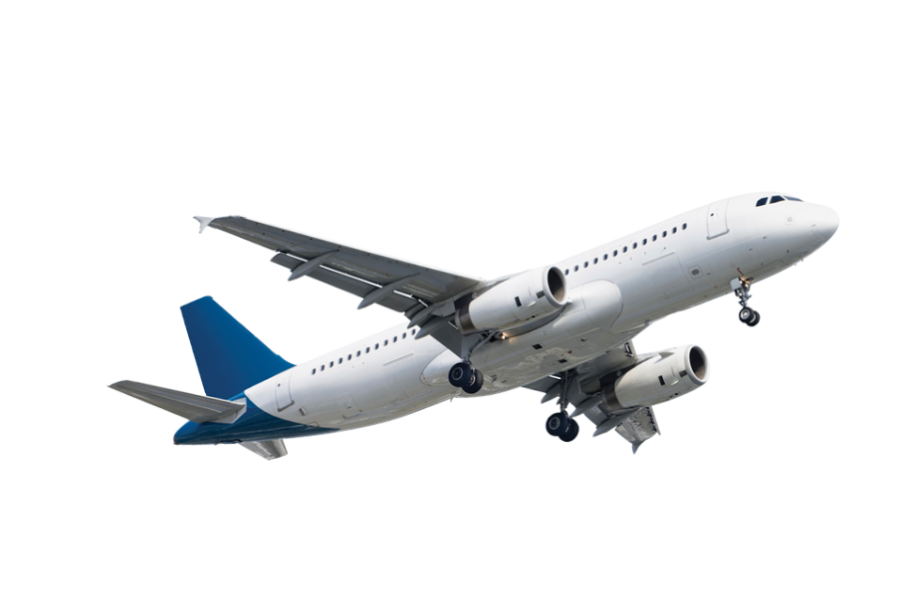

INTRODUCTION
Carbon Fiber Reinforced Polymer (CFRP)
High Strength,
Weight ratio &
Strong resistance to corrosion
Fiber Bragg Grating (FBG) Sensors
Good precision,
Anti-interference &
Ease to establish sensing signal

Slide 4
Composite laminate of different state excited by active actuation.
FBG sensor network applied to detect the dynamic responses.
Eigen frequency changes extracted by fourier transformation and set as damage characteristics.
BP neural network constructed: Input - damage characteristics Output - damage state.

Slide 5
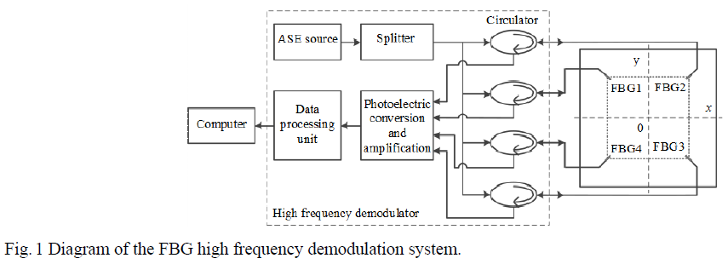
SYSTEM SETUP
Wavelengths of four FBG sensors are 1533.27nm, 1533.27 nm, 1533.28 nm and 1533.29 nm.

Slide 6
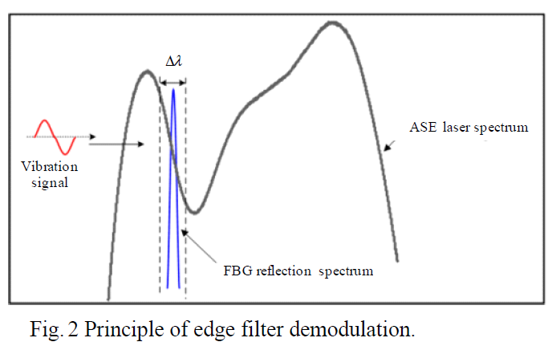
FBG SENSING THEORY
Combining with edge filter demodulation principle linear segment of ASE light source is used as edge filter to realize which frequency demodulation
Reflection peak change – reflection energy change – voltage signal

Slide 7
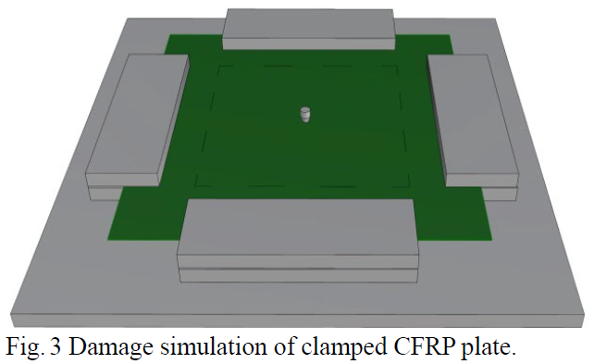
Lumped mass placed at centre

Slide 8
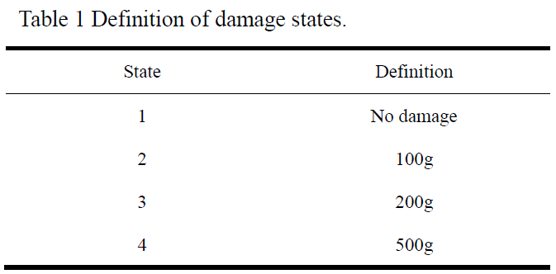

Slide 9
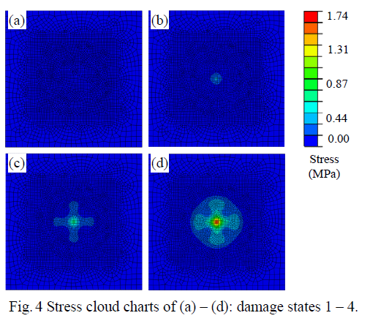
Lumped masses can stimulate structural damages

Slide 10
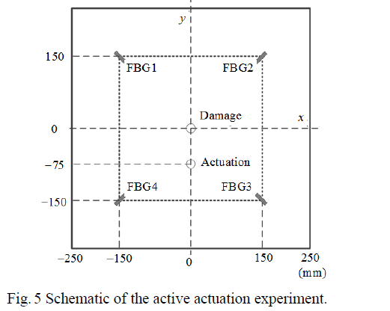
EXPERIMENT AND ANALYSIS

Slide 11
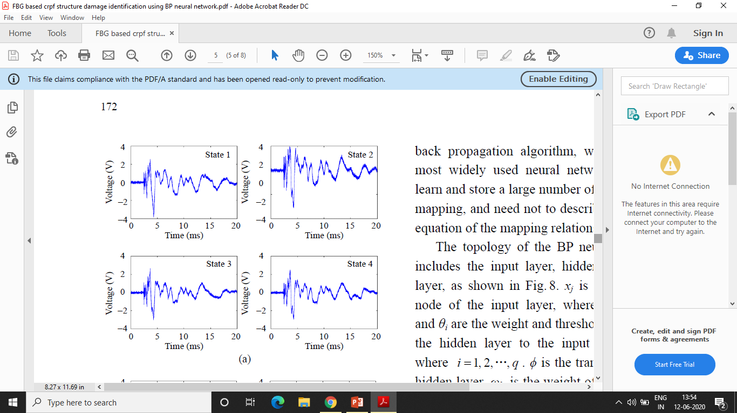
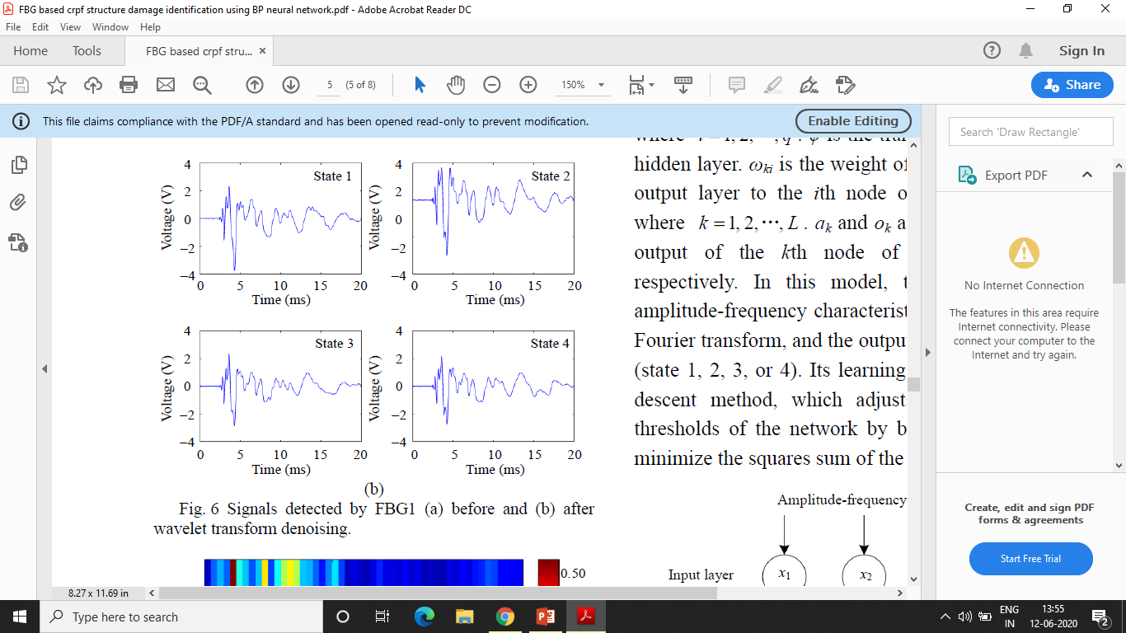
High Noise
db4 wavelet – 5 layer discrete wavelet transformation

Slide 12
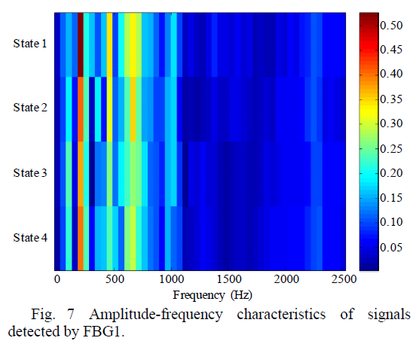
Frequency response vary under different state
Amplitude frequency characteristics and damage state has certain relationship

Slide 13
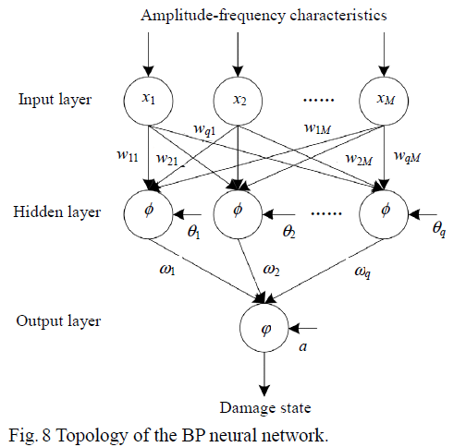

Slide 14
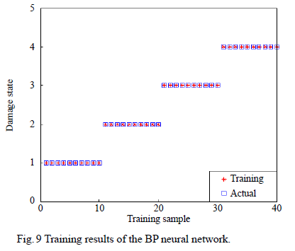
Neural network can learn from 40 group of training samples

Slide 15
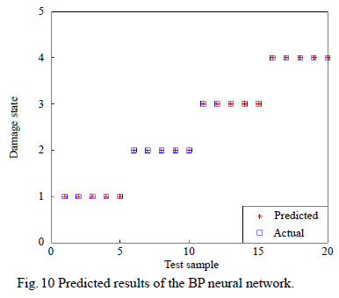

Slide 16
CONCLUSION
High-frequency demodulation system - dynamic response signals generated by the active actuation.
Lumped masses with different weights to simulate different damage degrees which are confirmed to be feasible by finite element analysis.
The BP neural network- to get damage states.
This paper provides a practical and easy way to realize the CFRP structural damage degree identification.

Slide 17
Impact Localization of CFRP Structure Based on FBG Sensor Network
Y. Z. Sai, X. Zhao, L. Wang, and D. Hau,“Impact Localization of CFRP Structure Based on FBG Sensor Network,” Photonic Sensors, Vol. 10, pp.88–96, March 2020.
Presenter: Ashish Kumar
Student ID: 108998404
Instructor: Prof. Peng-chun Peng

Slide 18
OUTLINE
Proposed work
Introduction
Signal Processing and Localization Algorithm
Experiment and Results
Conclusion

Slide 19
PROPOSED WORK
An impact localization system based on the fiber bragg grating (FBG) sensor network is proposed for impact detection and localization.

Slide 20
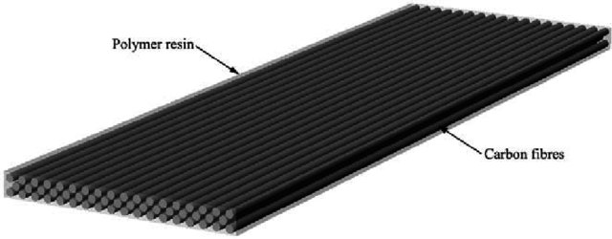
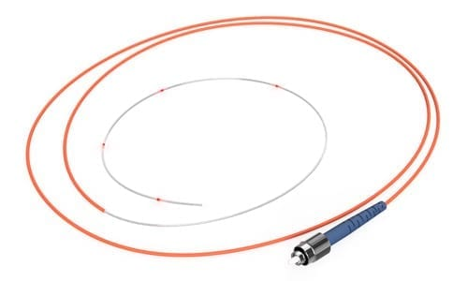
INTRODUCTION
Carbon Fiber Reinforced Polymer (CFRP)
High Strength,
Weight ratio &
Strong resistance to corrosion
Fiber Bragg Grating (FBG) Sensors

Slide 21
FBG sensors and high-speed demodulation - to acquire impact signals on the CFRP plate.
For the impact localization - wavelet packet decomposition is used to obtain different frequency band impact signals.
Energy of the signal - calculated as the characteristic sample.
For high accuracy localization - an extreme learning machine (ELM - only one parameter).

Slide 22
SIGNAL PROCESSING AND LOCALIZATION ALGORITHM
Impact signal (Broadband signal)
Frequency band signal (Different energies)
Distance increase
Energy attenuation different
Distance b/w impact source and sensors
confirmed by
energy change of frequency band signal (LOCALIZATION)
WAVELET PACKET DECOMPOSITION (Extract different band signal & calculate energies)

Slide 23
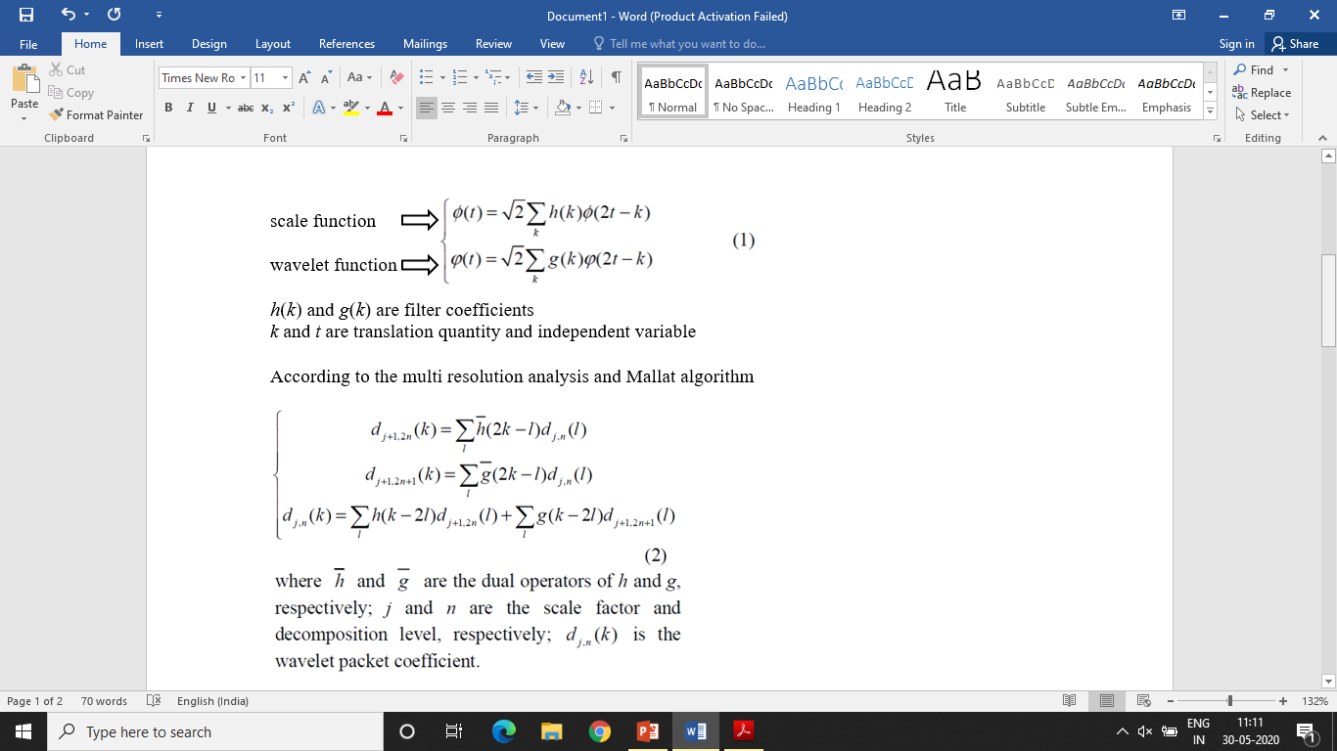
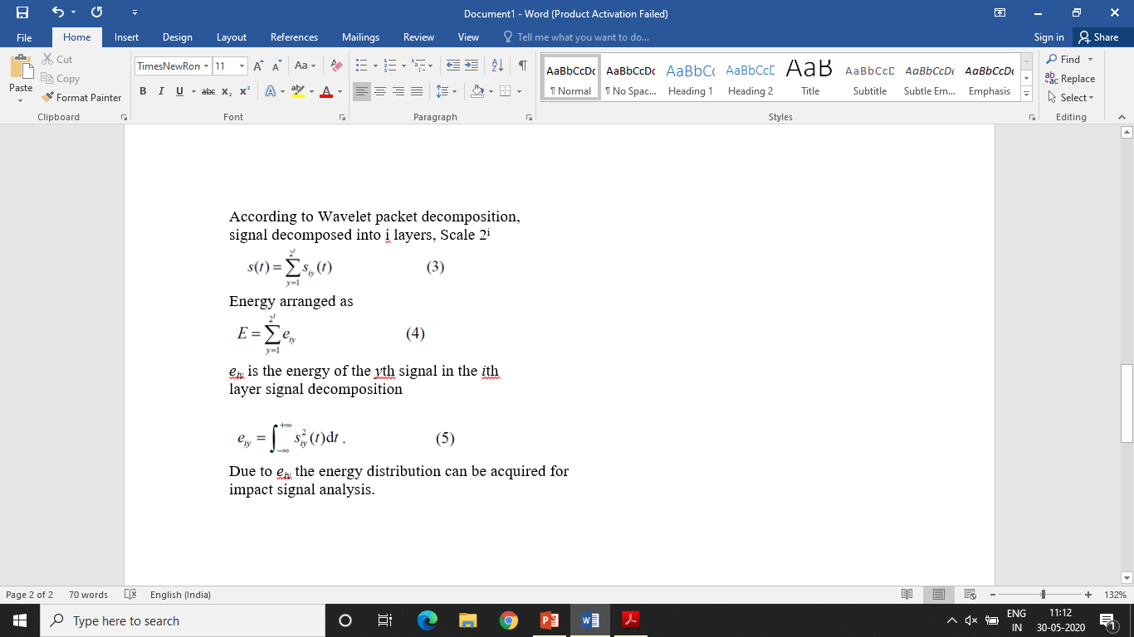

Slide 24
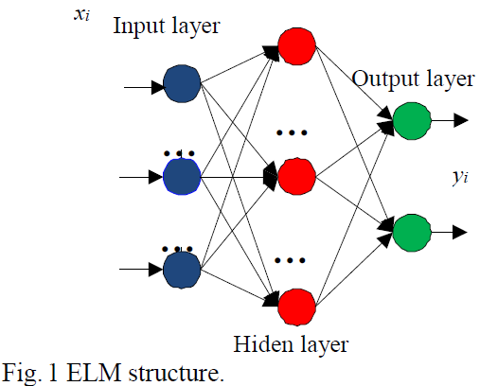

Slide 25
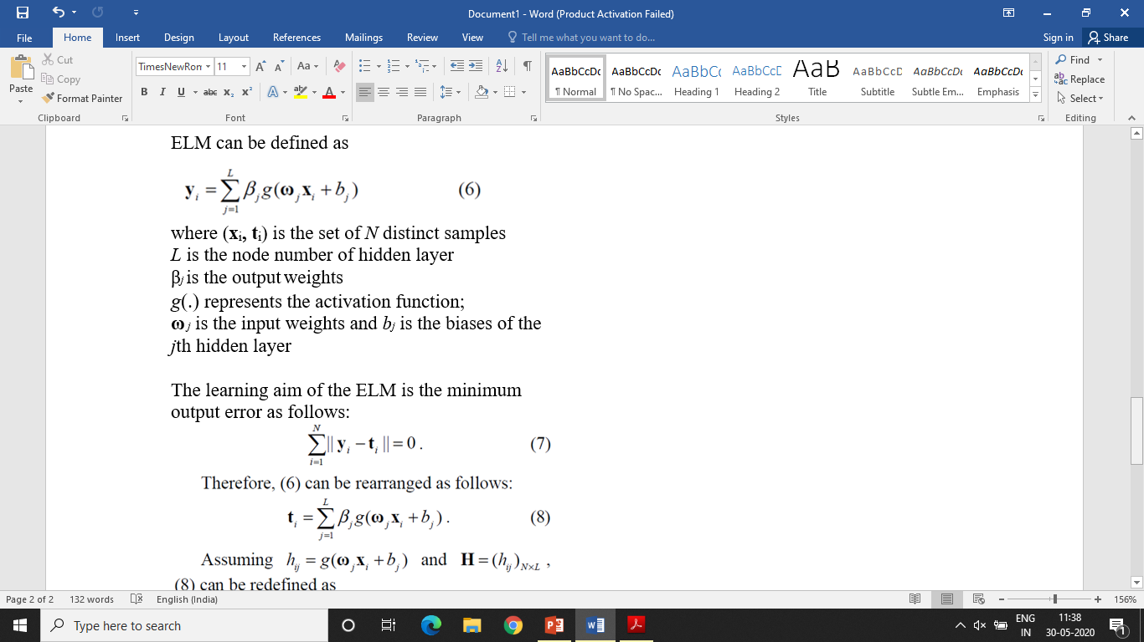
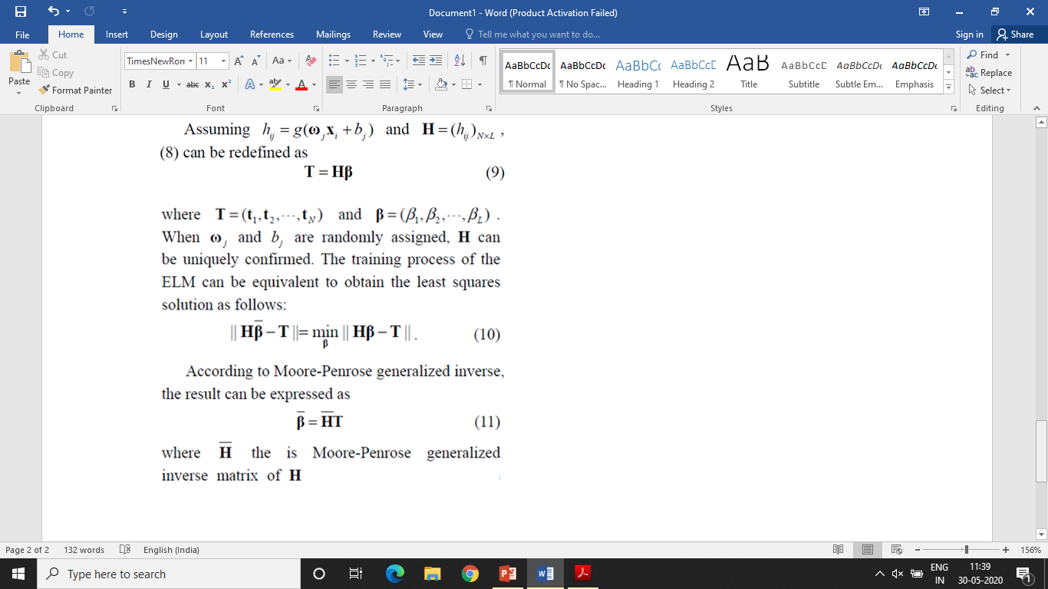

Slide 26
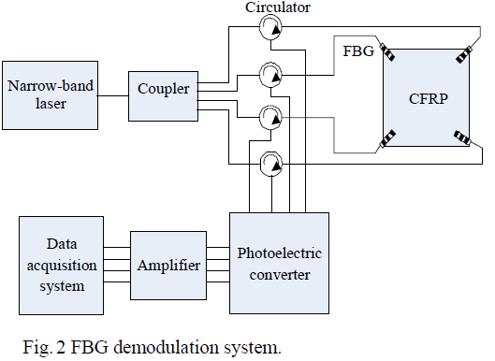
EXPERIMENT
Grating length of the FBG is 10 mm
Narrow-band laser is set as 1565.280 nm
Output power is 10 mW.
Sample frequency of the data acquisition system is 5 MHz.
Santec TSL-510
Reflectance wavelengths of four FBG sensors are 1565.255 nm, 1565.250 nm, 1565.255 nm and 1565.260 nm.

Slide 27
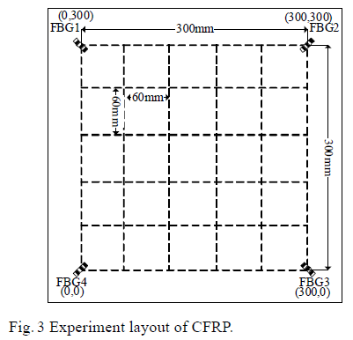
500 mm × 500 mm × 2 mm CFRP plate
Epoxy glue
Impact is simulated by steel ball impact and the impact energy is 0.2 J.

Slide 28
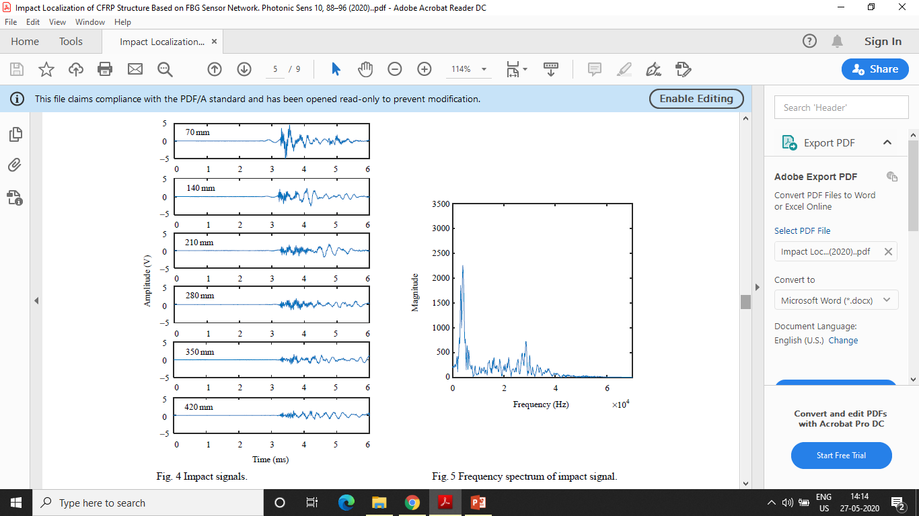
↑ Distance between impact source and FBG 3 Amplitude ↓

Slide 29

Frequency range 1Khz - 50Khz NOISE - no accurate relationship

Slide 30
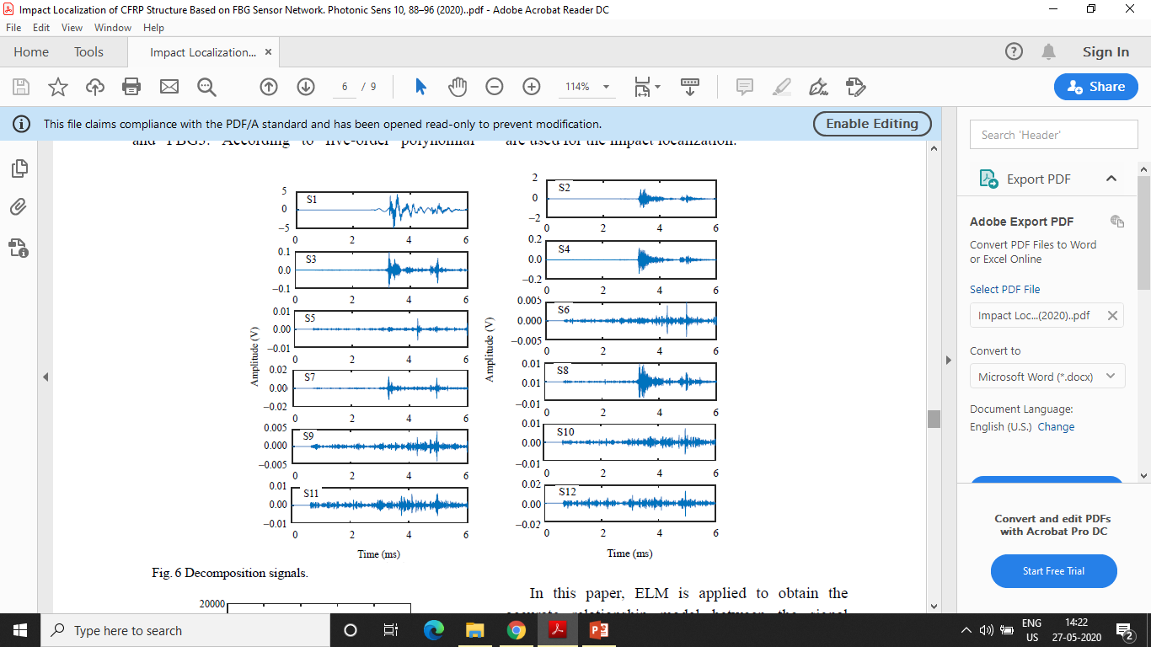
Wavelet packet function sym4
Layer number 6
64 different frequency band signals
Amplitude S1, S2, S3, S4 more then 0.05V

Slide 31
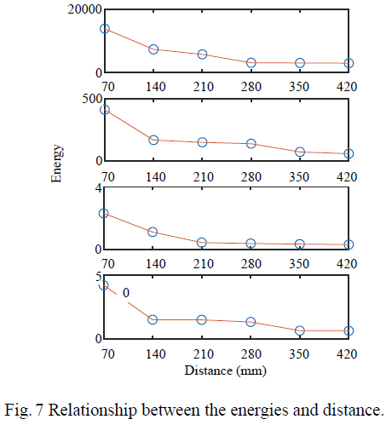
Five order polynomial fitting

Slide 32
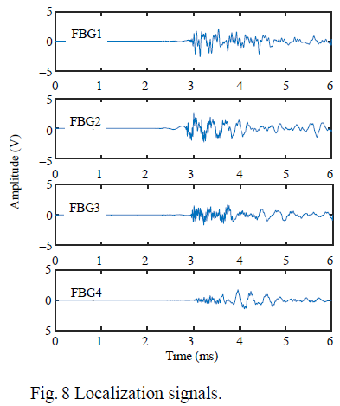
(190mm,250mm)

Slide 33
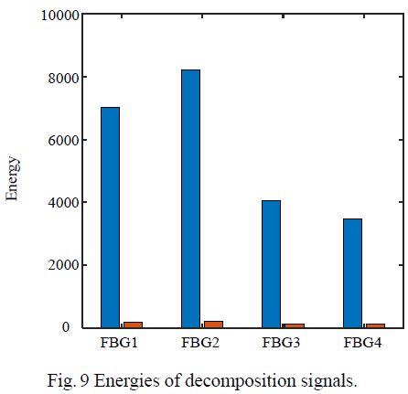

Slide 34
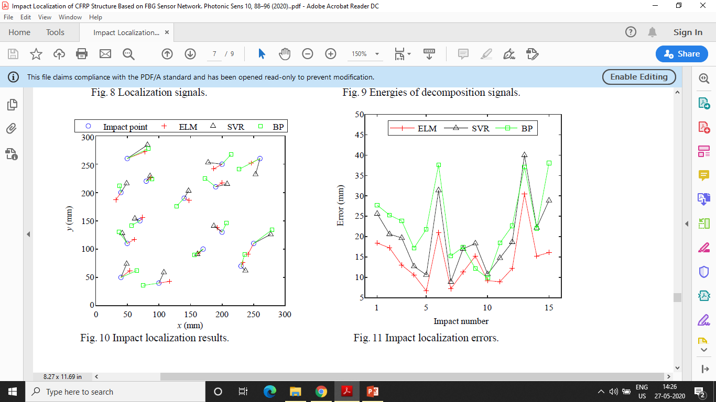

Slide 36
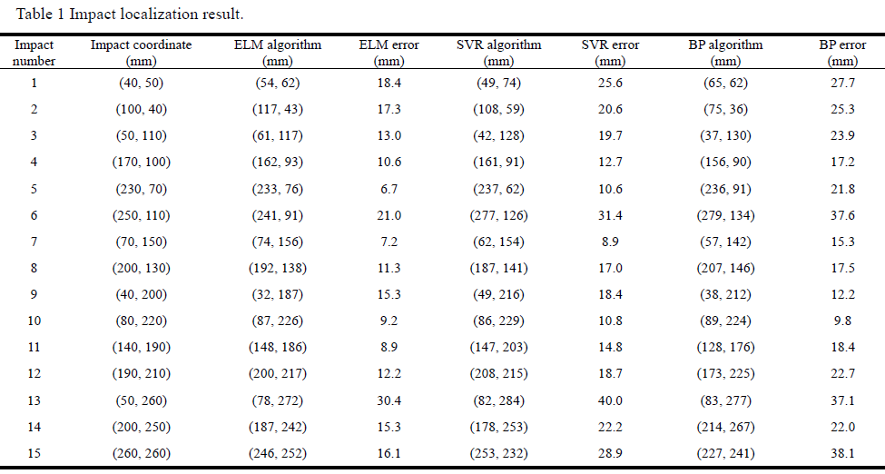

Slide 37
CONCLUSION
The maximum, minimum and average localization error localization error are 30.4 mm, 6.7 mm and 14.2mm respectively.
The training time is 0.7 s (better than 1.6 s and 3.2 s).
ELM has better results and less training time consumption with only one adjusted parameter.
The impact localization system and algorithm proposed provide important means and method for the high accuracy impact detection of the CFRP structure.

Slide 38
COMPARISON and CONTRAST
PAPER 1 | PAPER 2
CFRP structural damage identification | Impact Localization of CFRP structure
FBG sensor network is used | FBG sensor network is used
Invisible damages if not identified in time leads to structure threatening | Invisible damages if not identified in time leads to structure threatening
Eigen frequency changes are extracted by Fourier transformation (damage characteristics) | High speed demodulation to acquire impact signal & wavelet packet decomposition used
BP neural network constructed Input – damage characteristics Output – damage state | ELM neural network is used for high accuracy localization
Damage stimulated my lumped masses | Steel ball impact

Slide 39
COMMENTS
Paper 1 precisely focused on saving more cost and finding results in cheaper way as they used lumped masses.
Paper 1 has more precise details then paper 2 on conducting of experiment.
Both researches can be used for better use of CFRP in aerospace industry.
Paper 1 showed us how we can use the damage characteristics and paper 2 showed us how we can use wavelet packet decomposition for calculating energies.

Slide 40
Thank You!!謝謝

